Slide 1

Chapter 5
SOCIAL INTERACTION

Slide 2
Overview
What is meant by social interaction
The social mechanisms used in conversations
What is meant by social presence
Overview of technologies for supporting social interaction
How has social media changed how we keep in touch
New social phenomenon arising from being able to connect online

Slide 3
Social interaction
We live together, work together, play together, talk to each other, and socialize
Social technologies developed to enable us to persist in being social when apart
They differ in how they support us
Some encourage social interactions (for example, family games with Alexa)
Others have a negative impact on everyday conversations (Turkle, 2015)…

Slide 4
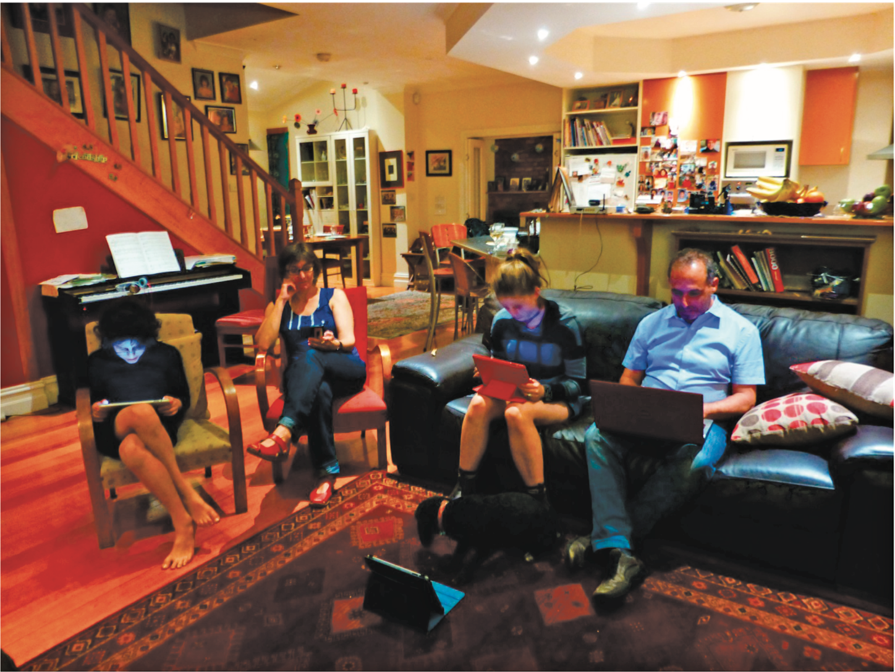
Are we spending too much time in our own digital bubbles?

Slide 5
Questions raised by social tech
Are F2F conversations being superseded by social media interactions?
How many friends do you have on Facebook, LinkedIn, WhatsApp, and so on versus real life?
How much do they overlap?
How are the ways that we live and interact with one another changing?
Are the established rules and etiquette still applicable to online and offline?
Notes:
Are the ways we live and interact with one another changing? Have the conventions, norms and rules–that have been established in face-to-face interactions to maintain social order been able to migrate to social media interactions? In particular, are the established conversational rules and etiquette – whose function it is to let people know how they should behave in social groups – also applicable to online social behavior?
5

Slide 6
Conversational mechanisms
Various mechanisms and ‘rules’ are followed when holding a conversation face to face, such as mutual greetings
A: Hi there
B: Hi!
C: Hi
A: All right?
C: Good, how’s it going?
A: Fine, how are you?
C: OK
B: So-so. How’s life treating you?

Slide 7
Conversational rules
Sacks et al. (1978) conversation analysis of conversations propose three basic rules:
Rule 1: The current speaker chooses the next speaker by asking an opinion, question, or request
Rule 2: Another person decides to start speaking
Rule 3: The current speaker continues talking

Slide 8
More conversational rules
Turn-taking used to coordinate conversation
A: Shall we meet at 8:00?
B: Um, can we meet a bit later?
A: Shall we meet at 8:00?
B: Wow, look at him?
A: Yes what a funny hairdo!
B: Um, can we meet a bit later?
Back channeling to signal to continue and following
Uh-uh, umm, ahh

Slide 9
Further conversational rules
Farewell rituals
Bye then, see you, yeah bye, see you later….
Implicit and explicit cues
For instance, looking at watch or fidgeting with coat and bags
Explicitly saying, “Oh dear, look at the time, I must go, I’m running late…”

Slide 10
Breakdowns in conversation
When someone says something that is misunderstood:
Speaker will repeat with emphasis:
A: “This one?”
B: “No, I meant that one!”
Also use tokens:
Eh? Quoi? Huh? What?

Slide 11
What happens in online conversations?
Do the same conversational rules apply?
Are there different kinds of breakdowns?
How do people repair them for:
Email?
Instant messaging?
Texting?
Skype or other videoconferencing software?
Notes:
Have new conversational mechanisms evolved for the various kinds of social media? For example, do people greet each other in the same way, depending on whether they are chatting online, Skyping or at a party? Do people take turns when online chatting in the way they do when talking with each other face-to-face? In order to answer these questions we next describe the core social mechanisms that exist in face-to-face interactions, followed by a discussion of the extent to which they remain or have been replaced with other mechanisms in online interactions.
On the phone: The person answering the call will initiate the conversation by saying “hello” or more formally, the name of their company/department (and sometimes the phone number being called). Many phones now have caller ID letting the person answering the call know who he is talking to, which can enable him to be more personal, for example, “Hello John, how are you doing?” Phone conversations usually start with a mutual greeting and end with a farewell one.
In contrast, conversations that take place via online chatting or IM have evolved new conventions. The use of opening and ending greetings when joining and leaving are rarely used; instead most people simply start their message with what they want to talk about, and then stop when they have got an answer, as if in the middle of a conversation
11

Slide 12
Remote conversations
Much research on how to support conversations when people are ‘at a distance’ from each other
Many applications have been developed
For example, email, videoconferencing, instant messaging, and chatrooms
Do they mimic or move beyond existing ways of conversing?

Slide 13
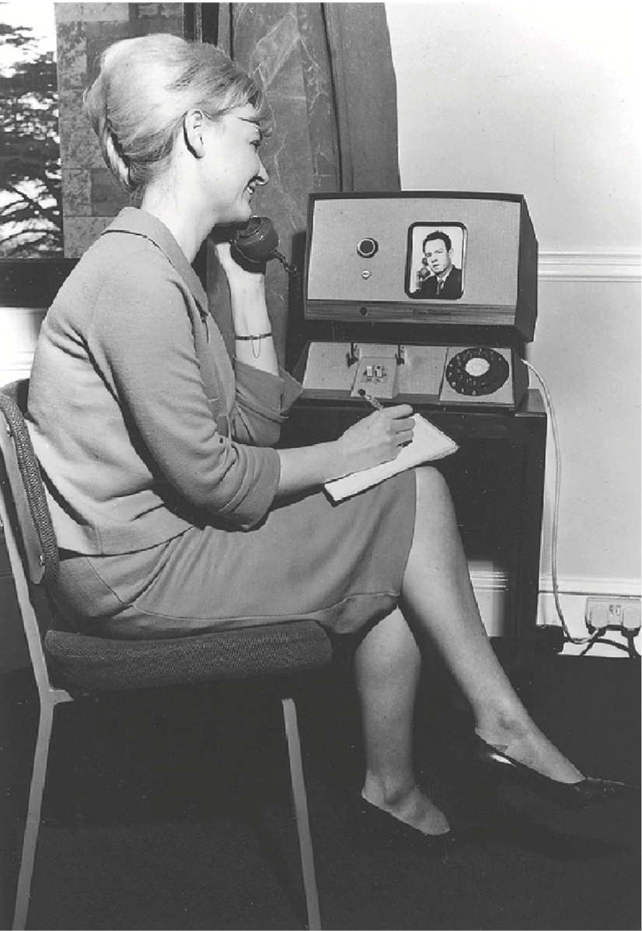
Early videophone from the 1960s
Notes:
Figure 4.1

Slide 14
VideoWindow system (Bellcore, 1989)
Shared space that allowed people 50 miles apart to carry on a conversation as if in same room drinking coffee together
3 x 8 foot ‘picture-window’ between two sites with video and audio
People did interact via the window, but strange things happened (Kraut, 1990)
Notes:
14
Two lounge areas, that were 50 miles apart, were connected with high bandwidth video channels and full duplex four channel audio. Connecting them was a 3 by 8 foot wide ‘picture-window’, onto which video images were projected. The large size was meant to allow those viewing it to see a room of people roughly the same size as them. The system was designed to be active 24 hours a day, whereby anyone entering one room could speak to whoever happened to be in the other room.
A study by Kraut et al (1990) of how effective the system was, showed that in general, many of the interactions that took place between the co-located conversants were indeed indistinguishable from similar face-to-face interactions – with the exception that they spoke a bit louder and constantly talked about the video system. However, they also found that people who were in the same room tended to talk more with each other than with those in the video-linked room. Various usability problems were identified as contributing to this reluctance to talk with video-images of other people. One of these was the tendency for people to move closer to the picture-window to strike up a conversation with someone (which is what one would normally do in a face-to-face setting), but which had the opposite effect of what the person intended, as it moved their head out of the picture (since they were no longer under the camera) and also out of microphone range, meaning they could not be seen or heard. Thus rather than getting nearer to the other person they wanted to talk to, their behavior had the counter-intuitive effect of removing them from the ‘picture’. Moreover, there was no way of each participant knowing whether they were being seen and heard by the others in the other room. This inability to monitor how the other person is or not ‘receiving’ you caused numerous problems. Another problem that became apparent was that the system only allowed public conversations, meaning that they could be heard by everyone in the rooms. Such public broadcasting contrasts with how people normally engage in informal face-to-face conversations, where they will often whisper and conspire with each other when a topic becomes more private or secret. Such private conversations were clearly not able to be supported by the VideoWindow system.

Slide 15
Diagram of VideoWindow in use

Slide 16
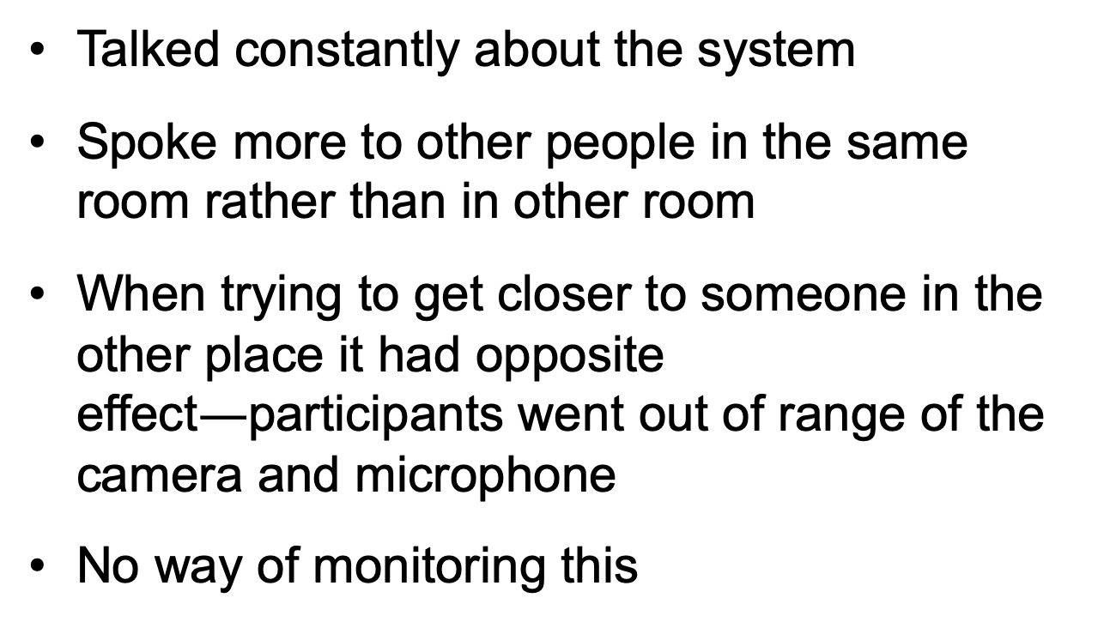
Findings of how VideoWindow System was used
Talked constantly about the system
Spoke more to other people in the same room rather than in other room
When trying to get closer to someone in the other place it had opposite effect$—$participants went out of range of the camera and microphone
No way of monitoring this

Slide 17
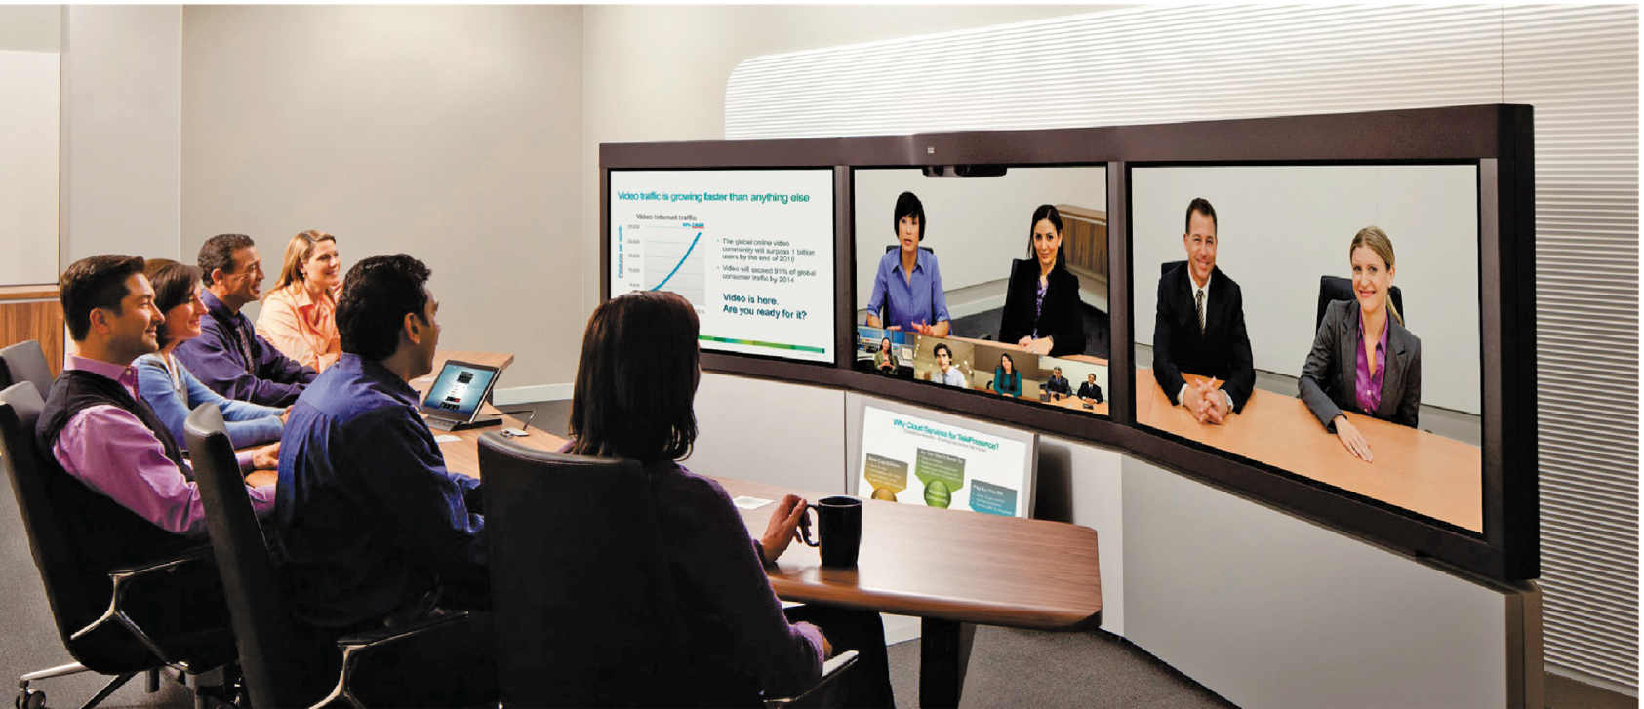
Videoconferencing and telepresence rooms
Many to choose from to connect multiple people (for instance, Zoom)
Customized telepresence rooms for groups

Slide 18
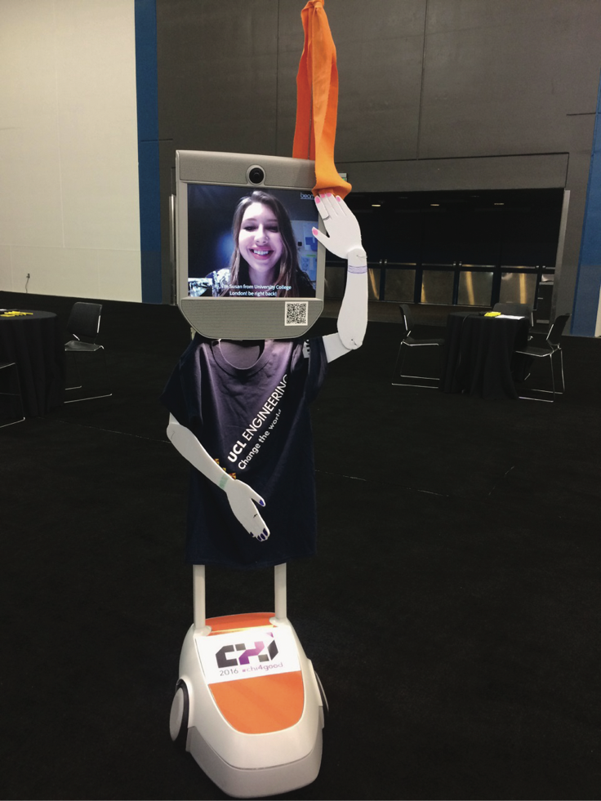
Telepresence robots
Enable people to attend events who could not do so, such as by controlling their robot remotely
In places such as schools, conferences, and museums
Early example: Beam+
Often dressed up to appear like the person to others at the event
Positive experience of being there
Susan Lechelt at ACM CHI

Slide 19
Telepresence and social presence
Telepresence refers to one party being present with another party, who is present in a physical space, such as a meeting room
Social presence refers to the feeling of being there with a real person when in virtual reality

Slide 20
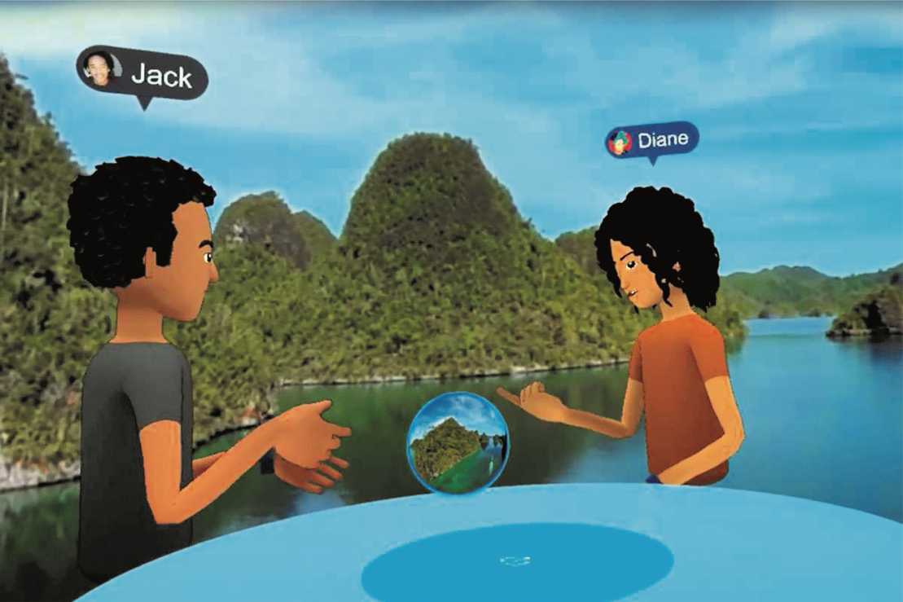
Facebook’s vision of socializing in a 3D world using VR
Two avatars talking at a virtual table
Users experience each other through donning VR headsets

Slide 21
How much realism and immersion are necessary..?
…in telepresence to make it compelling?
Telepresence rooms try to make remote people appear to be life-like
Use multiple high definition cameras with eye-tracking features and directional microphones
Does FaceTime have as much presence as more high definition settings?

Slide 22
What is co-presence?
Co-located groups who want to collaborate
Many technologies have been designed to:
Enable groups to work, learn and socialize more effectively together
For example, tabletops, whiteboards, and public displays

Slide 23
Coordination mechanisms
When a group of people act or interact together, they need to coordinate themselves
For example, when playing football or navigating a ship
To do so, they use:
Verbal and non-verbal communication
Schedules, rules, and conventions
Shared external representations

Slide 24
F2F coordinating mechanisms
Talk is central
Non-verbal also used to emphasize and as a substitute
For instance, nods, shakes, winks, glances, gestures, and hand-raising
Formal meetings
Explicit structures such as agendas, memos, and minutes are employed to coordinate the activity

Slide 25
Awareness mechanisms
Involves knowing who is around, what is happening, and who is talking with whom (Dourish and Bly, 1992)
Peripheral awareness
Keeping an eye on things happening in the periphery of vision
Overhearing and overseeing—allows tracking of what others are doing without explicit cues
Situational awareness
Being aware of what is happening around you in order to understand how information and your actions will affect ongoing and future events
For example, air traffic control or an operating theatre

Slide 26
Sharable interfaces
Designed to capitalize on existing forms of coordination and awareness mechanisms
Several studies investigating whether they help people to work together better, have found:
More equitable participation
More natural to work around
More comfortable sitting around a table than standing in front of a display

Slide 27
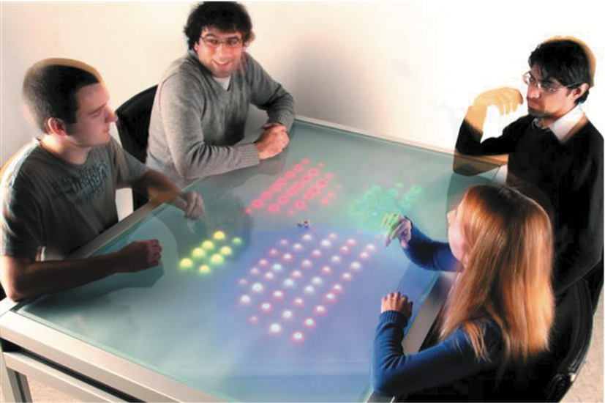
The Reflect Table
LEDs lit up to reflect how much each member of the group spoke
Used microphones in front of each individual to do this
Study showed those who spoke the most changed their behavior the most
Those who spoke the least did not change their behavior
Why do you think this is?

Slide 28
Sococo floor plan of a virtual office: who is where and who meeting with whom

Slide 29
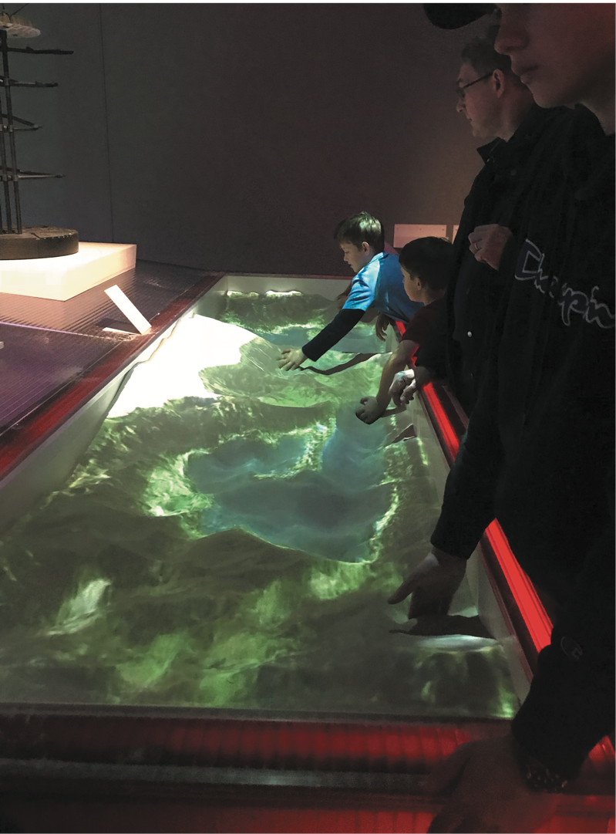
Playing together in same space
Visitors using an AR sandbox at the V and A
Visitors sculpt landscapes out of sand
System reacts with changing superimposed digital colored landscape
Enables creative forms of collaboration

Slide 30
Social engagement
Refers to participation in activities of a social group
Social exchange where people give or receive something from others
Voluntary, unpaid and often altruistic (in the sense of sharing and doing good for others)
Websites often used as hub to connect people
Retweeting is a powerful way of connecting millions of people…

Slide 31

Retweeting goes viral
The epic Twitter battle between Ellen DeGeneres and Carter Wilkerson
Millions retweeted in the space of hours
Connected millions of people for a fun cause
Many people found it amusing to join in and watch the numbers grow

Slide 32
Dilemma: Is it OK to talk with a dead person using a chatbot?
Eugenia Kuyda lost a close friend in a car accident who was only in his 20s
She took all his texts sent over the course of his life and made a chatbot using them
Chatbot responds to text messages so that Eugenia can talk to her friend as if he was alive
Is this a creepy or comforting way to deal with grief?
Is it respectful of the dead person?

Slide 33
Summary
Social interaction is central to our everyday lives
Social mechanisms, like turn-taking, enable us to collaborate and coordinate our activities
Keeping aware of what others are doing and letting others know what you are doing are important aspects of collaborative working and socializing
Many technology systems have been built to support telepresence, social presence, and co-presence
Social media has brought about significant changes in how people keep in touch and manage their social lives

